Slide 1
Come Fly With Me
An insight into aviation traffic within Australia

Slide 2
Why is aviation important?
Aviation is a growing necessity in keeping our modern world connected
Australia is especially reliant on aviation due to a lack of land borders

Slide 3
Aims
Investigate seasonal patterns in activity
Find growing hotspots in Australia

Slide 4
Data Source

Slide 5
Aviation statistics are published by the Bureau of Infrastructure, Transport, and Regional Economics (BITRE)
International & domestic activity are both available

Slide 6
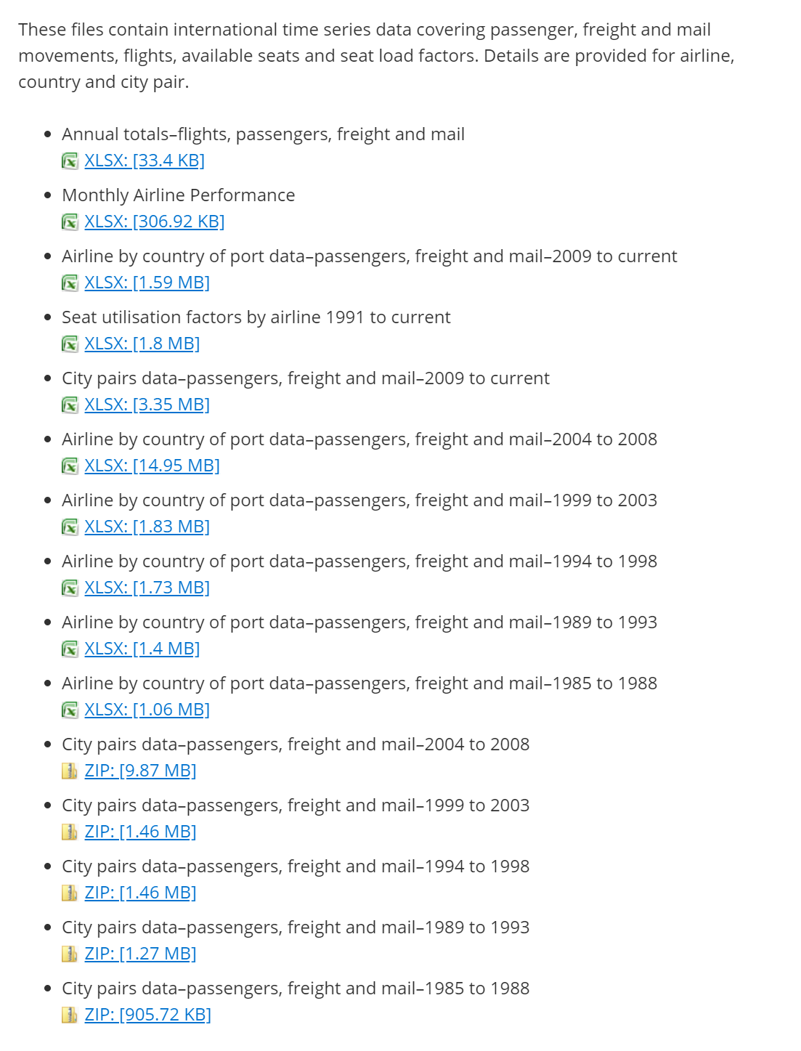
International
City pairs datasets are the most interesting

Slide 7
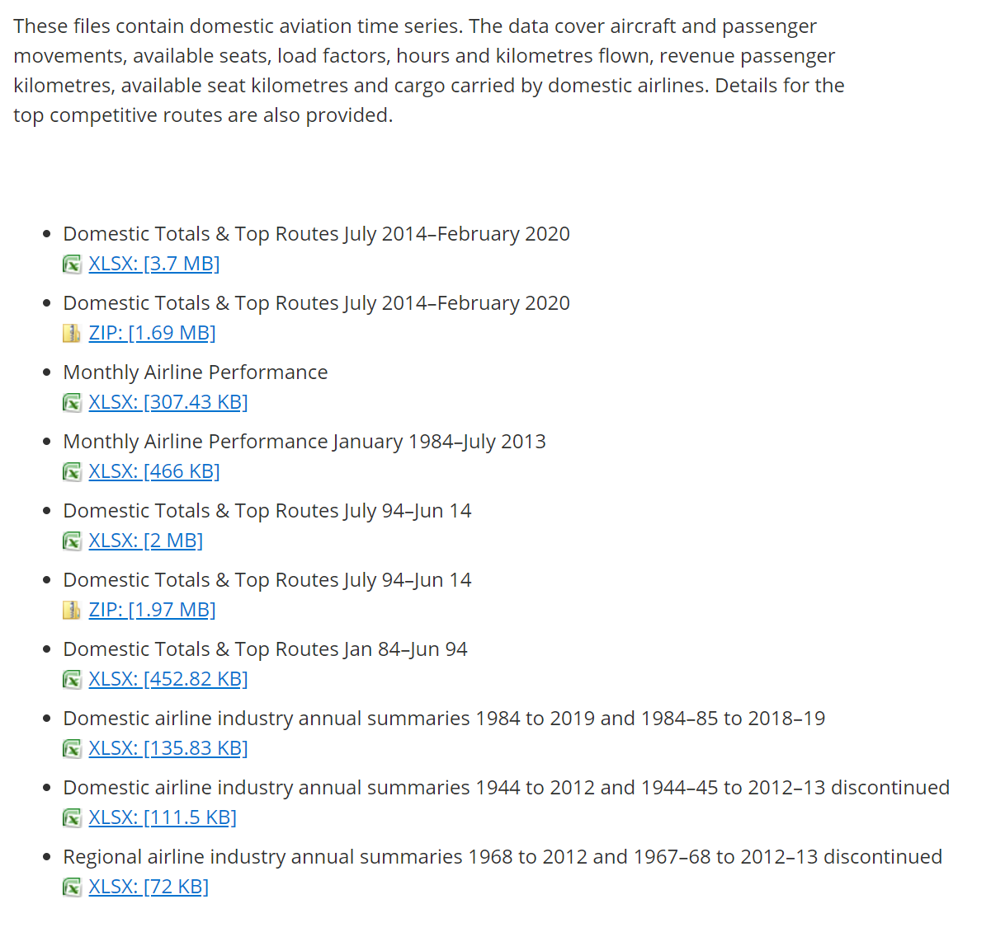
Domestic
Domestic Top Routes is similar to the International City Pairs data

Slide 8
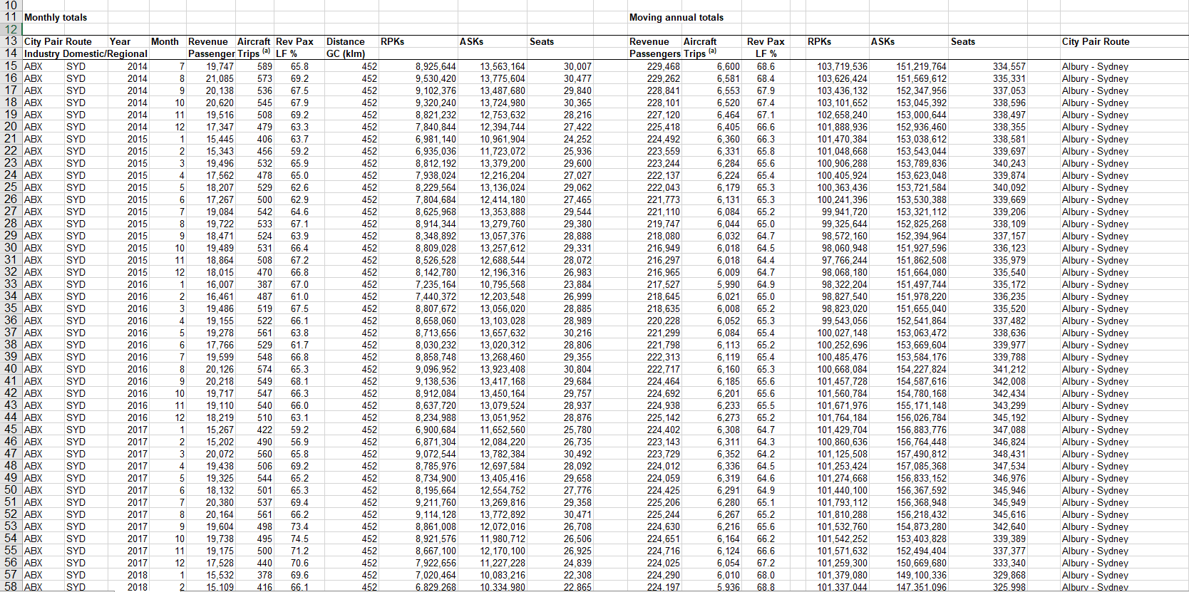

Slide 9
Processing

Slide 10

pandas used to combine excel spreadsheets into a data frame
Remove unnecessary columns while importing

Slide 11

xarray provides fantastic n-dimensional arrays
Pandas data is then converted to an xarray structure – simplifying working with multidimensional data

Slide 12
Visualisations are done using matplotlib

Slide 13
International Visualizations

Slide 14
Initial Visualizations
Important part for initial visualizations is to see overall Australian trends at a glance

Slide 15
Initial Visualizations
Important part for initial visualizations is to see overall Australian trends at a glance
To understand individual airports, it’s important to understand Australia as a whole

Slide 16
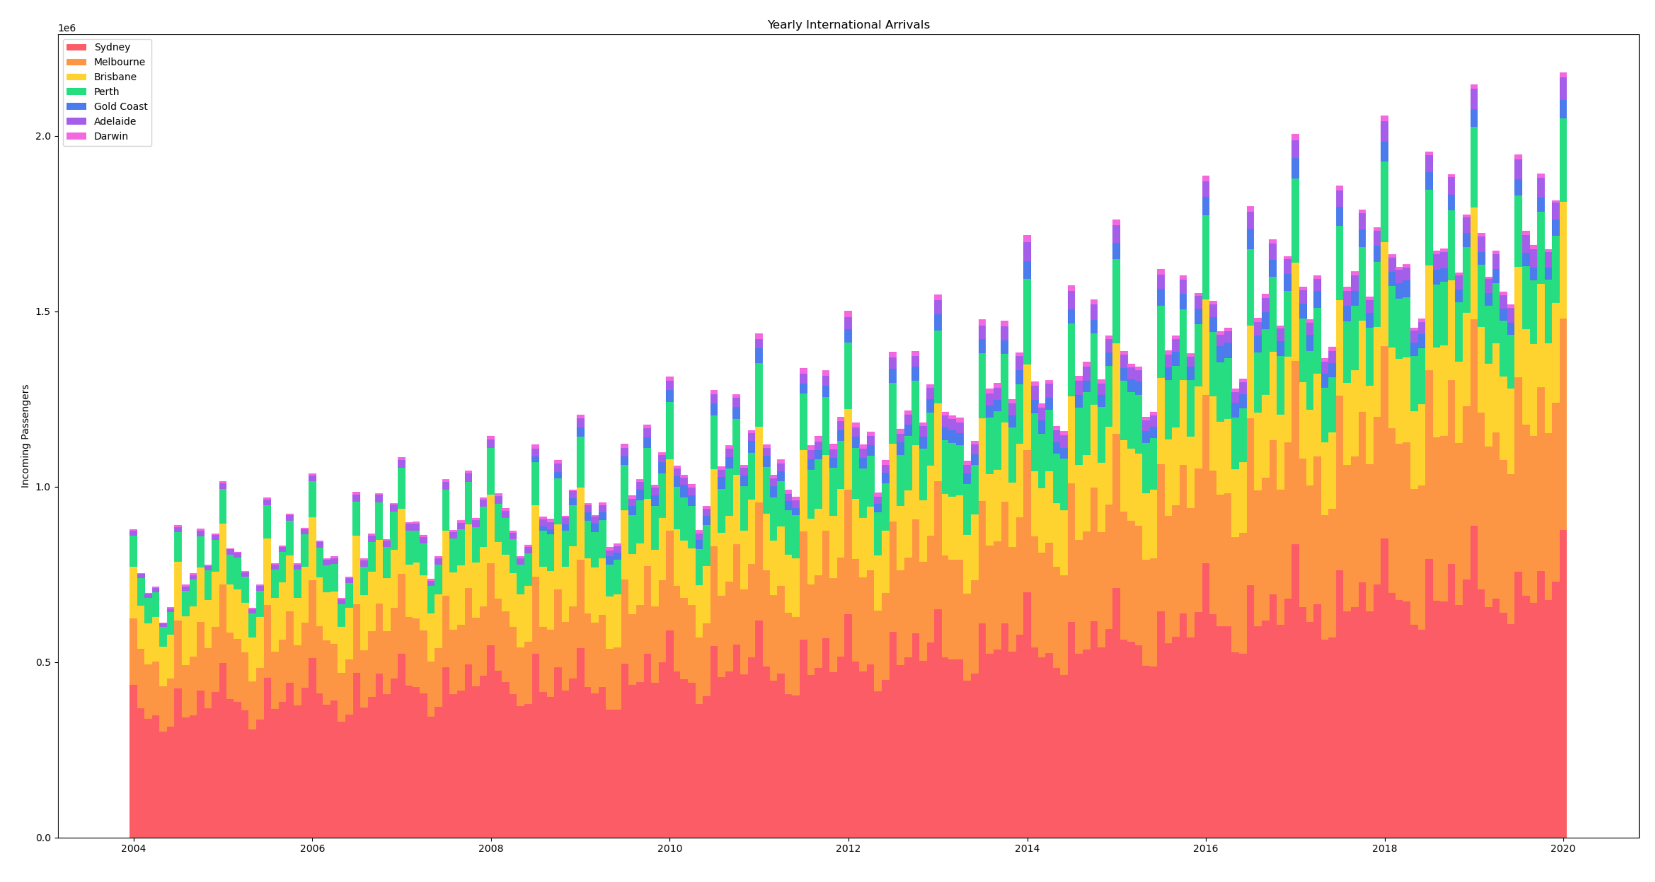
Yearly Arrivals
Stacked bar chart showing total arrivals in Australia each month
Arrivals are trending upward as times goes on
Volume oscillates on a seasonal basis

Slide 18
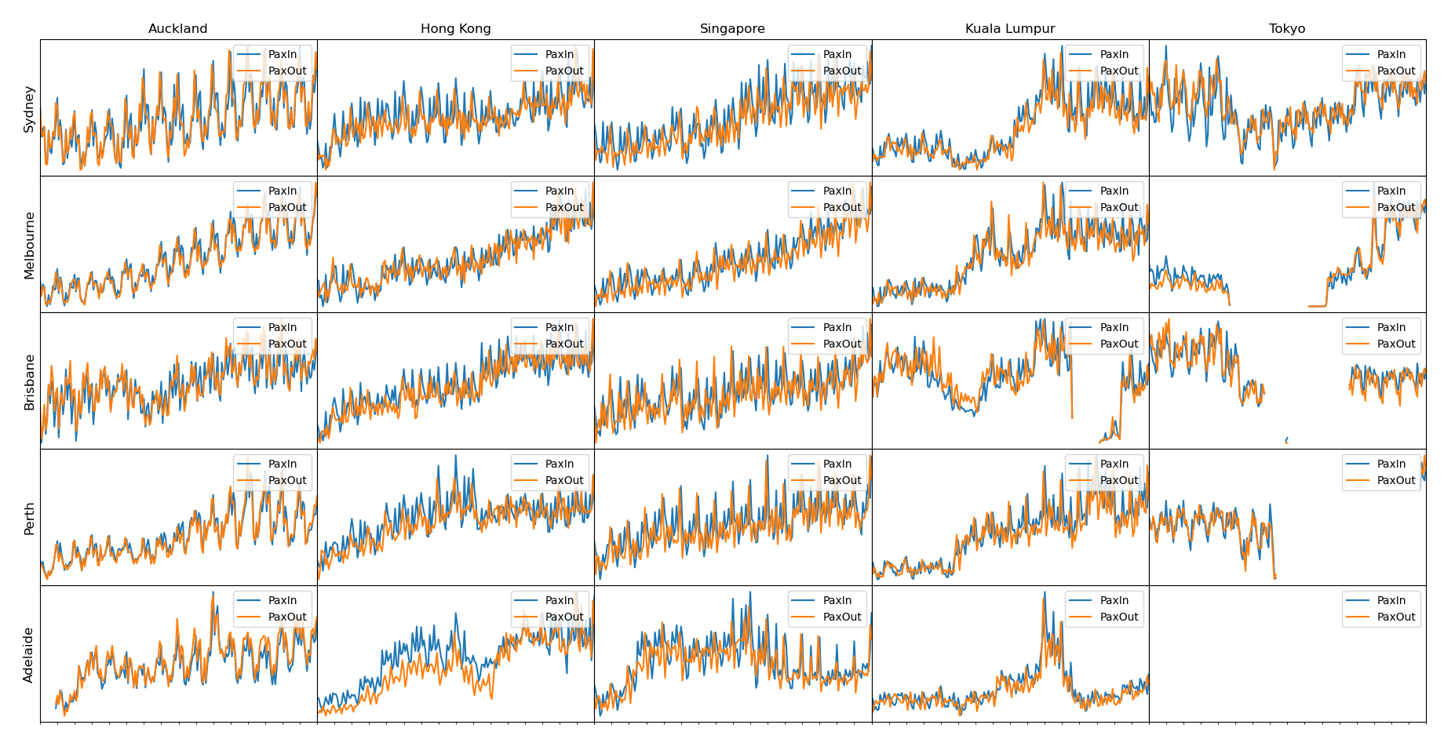
Trends
Trend graphs between various locations in Australia and international hotspots
Axes between charts are not to scale – trends only!
Similar upwards trend is visible
Seasonal fluctuations are more pronounced

Slide 20
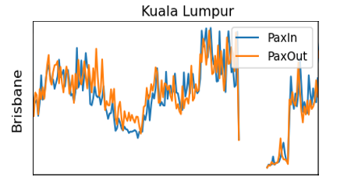
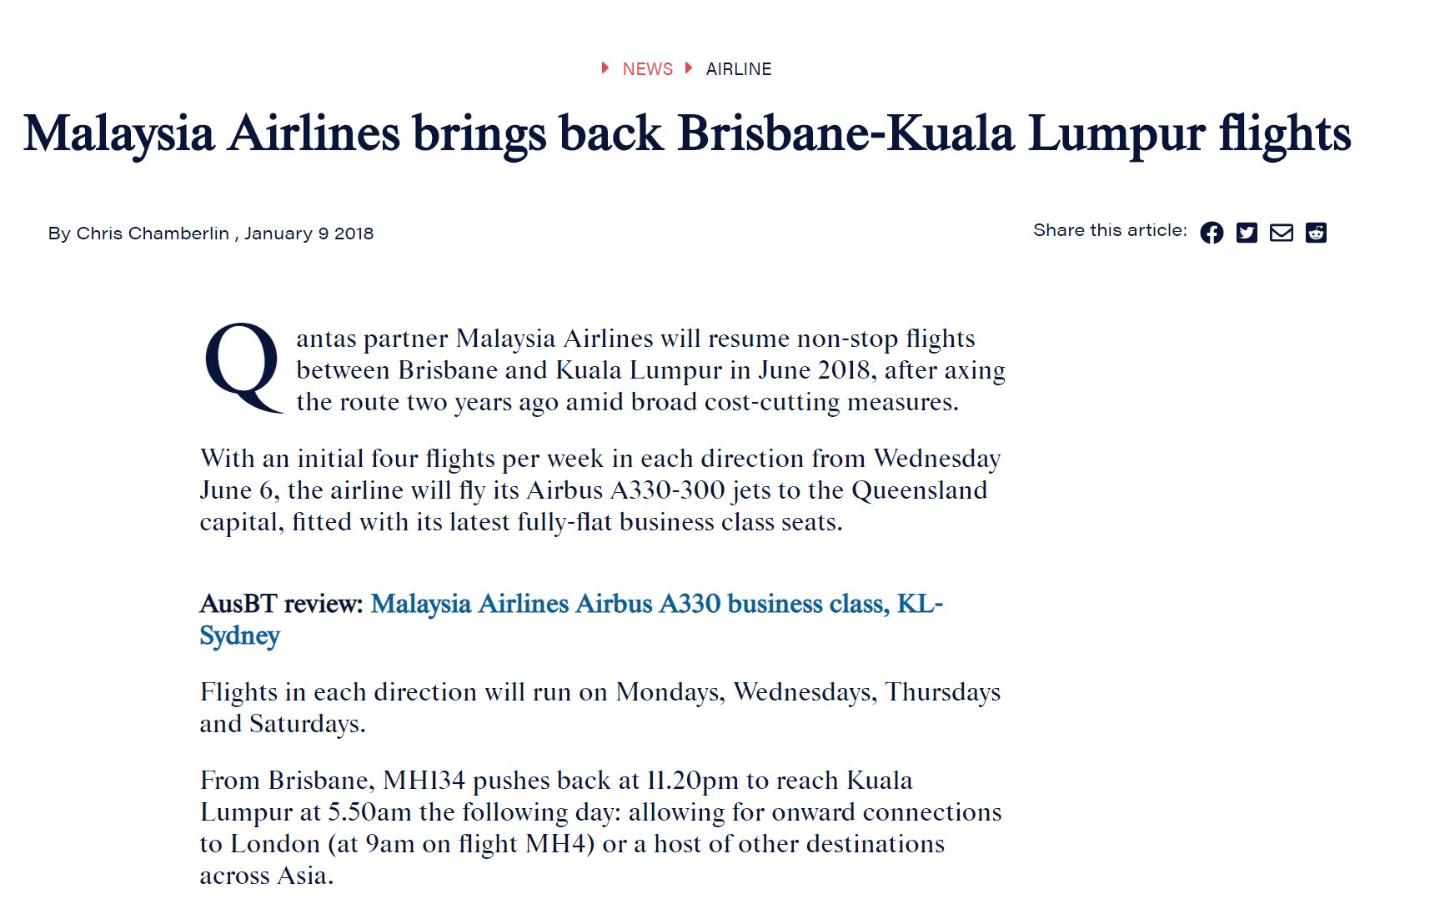
Trends
Certain events can have major impacts in the data

Slide 21
Trends
Is there a better way to view the seasonal trends?

Slide 22
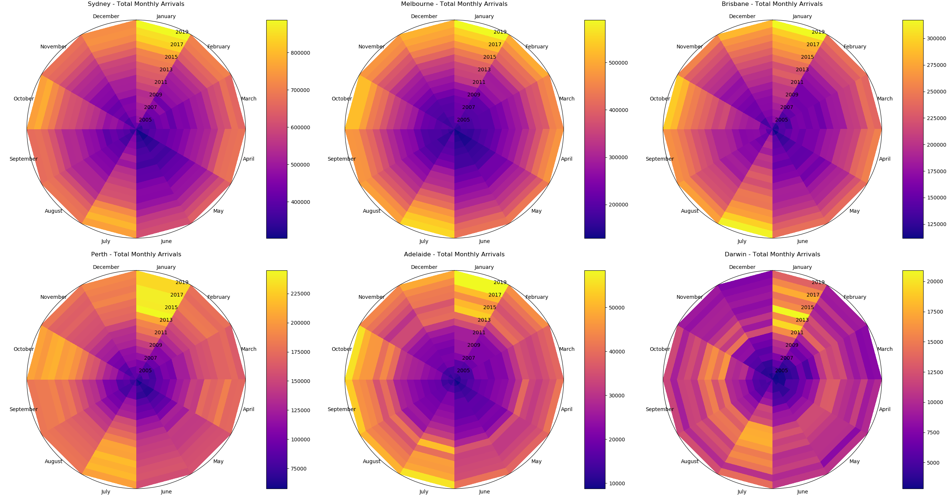

Slide 23
